Slide 1
SplitEasy
Group 11
Guide TA - Pinak Gajera

Slide 2
IT 314 - Software Engineering
Expense Management System
Student Name | Student ID
Ayush Bhalani | 201901048
Anish Parekh | 201901058
Neel Patel | 201901068
Jay Makwana | 201901104
Monil Charola | 201901119
Siddharth Rathod | 201901162

Slide 3
Introduction
In our daily life, we have to keep track of our expenses and keep a note of the amount we owe to our friends/relatives or the amount they owe us.
Manually keeping track of these expenses will be inefficient, time-consuming, and error-prone.
This project is meant to offer a shared expenses solution that is faster, easier, and more convenient than manually calculating and handling expenses.

Slide 4
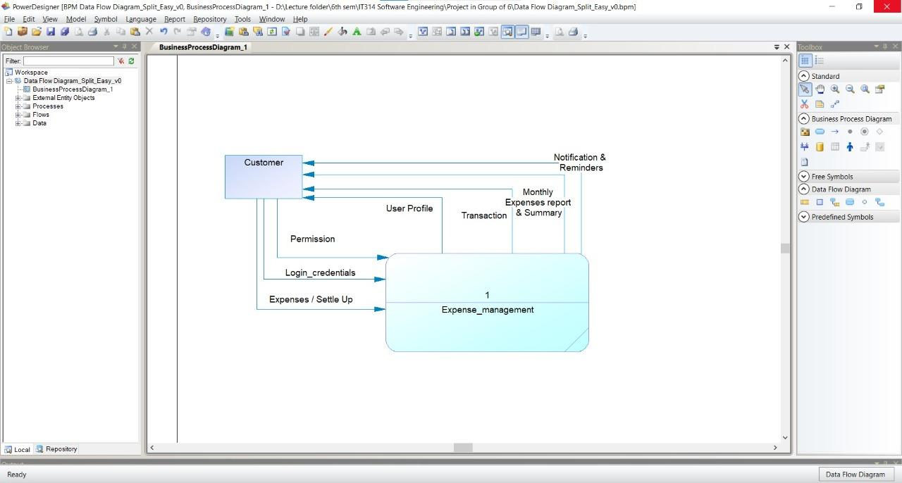
Context Diagram

Slide 5
Functional Summary
Users can add or settle expenses, either in the group or with an individual person
Monthly expense report
Users can ping their friends
User should be able to add personal information and set their profile

Slide 6
Functional Summary
Support transactions in multiple currencies
Intuitive and Easy User Interface
Transaction Activity Log

Slide 7
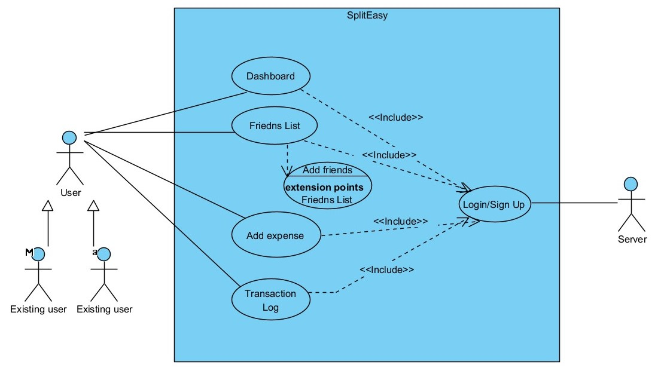
Top Level Use Case Model

Slide 8
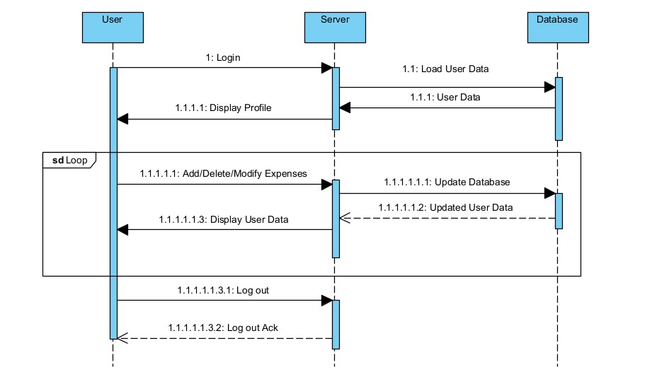
Sequence Diagram

Slide 9
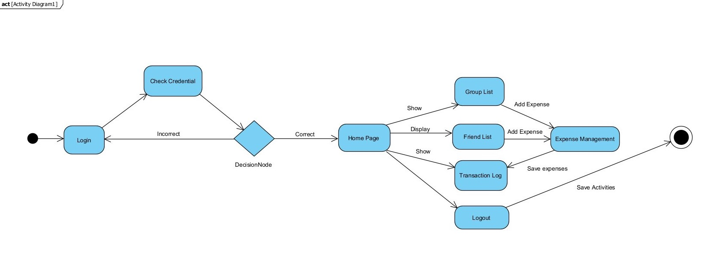
Activity Diagram

Slide 10
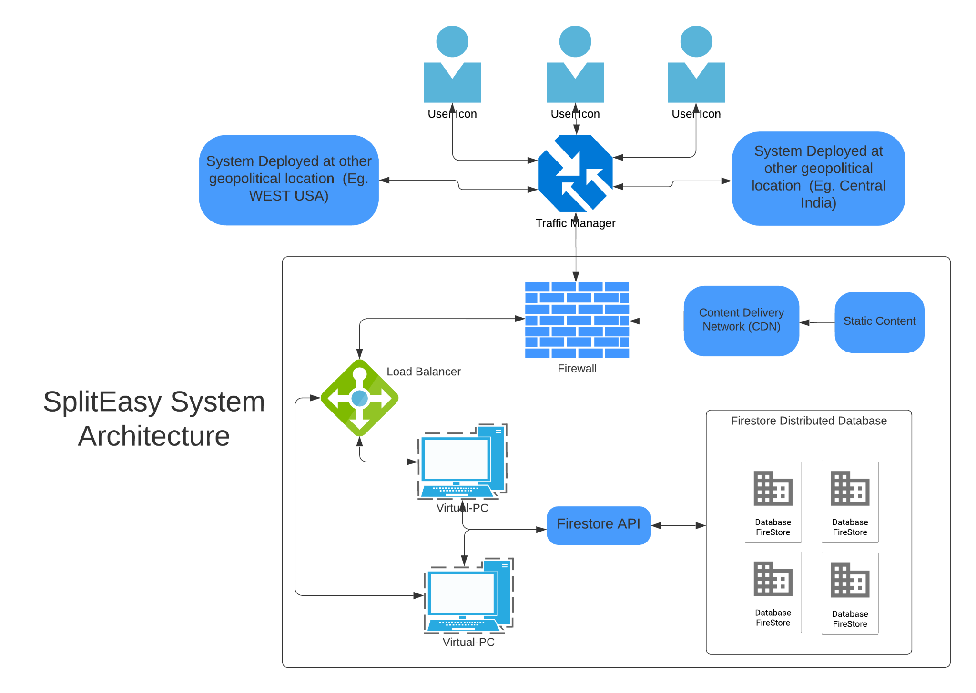
Application Architecture

Slide 11
Technology/Tools and Libraries
IDE (Integrated Development Environment) - VS Code and Atom
Programming Languages - JavaScript, HTML, CSS
Multiple relevant React JS Libraries
Material UI - Core/Icons
Bootstrap
Database Technology - Firebase (Google Cloud Storage)
Authentication - Google OAuth

Slide 12
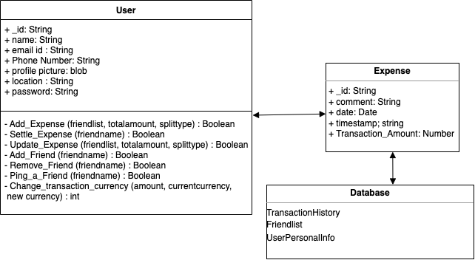
Detailed Class Diagram

Slide 13
Summary of Implementation
Our Goal was to implement a web-application that serves the purposes and functionalities as defined in our SRS document for SplitEasy.
We conducted a short research and found out that React Js with Google’s firebase for the backend services would be suitable for our project.
The only hurdle we faced as a team was that not everyone in the team were well versed with React Js.
Once finalising upon the tools and technologies we planned out a proper timeline and milestones.
We distributed the components and the tasks amongst the team members.
Various regular observations and feedbacks from our peers stimulated improvement in our system.

Slide 14
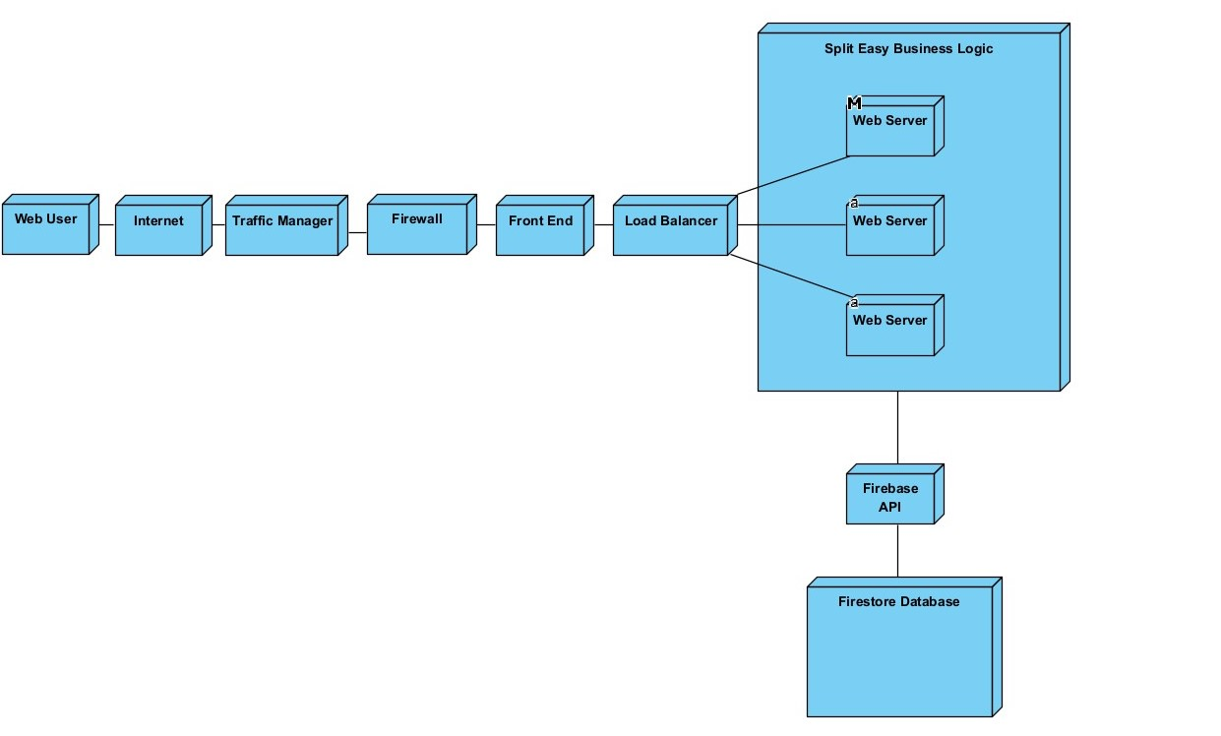
Deployment Diagram
Notes:
Definition
Web user has theori own devices

Slide 15
Individual Contribution of each member
Student Name | Student ID | Contribution
Ayush Bhalani | 201901048 | Frontend Implementation, Wireframe, Solution designing
Anish Parekh | 201901058 | Backend Implementation, Testing and Debugging
Neel Patel | 201901068 | Backend Implementation, Solution designing
Jay Makwana | 201901104 | Frontend Implementation, Testing and debugging
Monil Charola | 201901119 | UI/UX Implementation, Documentation, Testing and debugging
Siddharth Rathod | 201901162 | Wireframe, Designing, Documentation, Testing and debugging

Slide 16
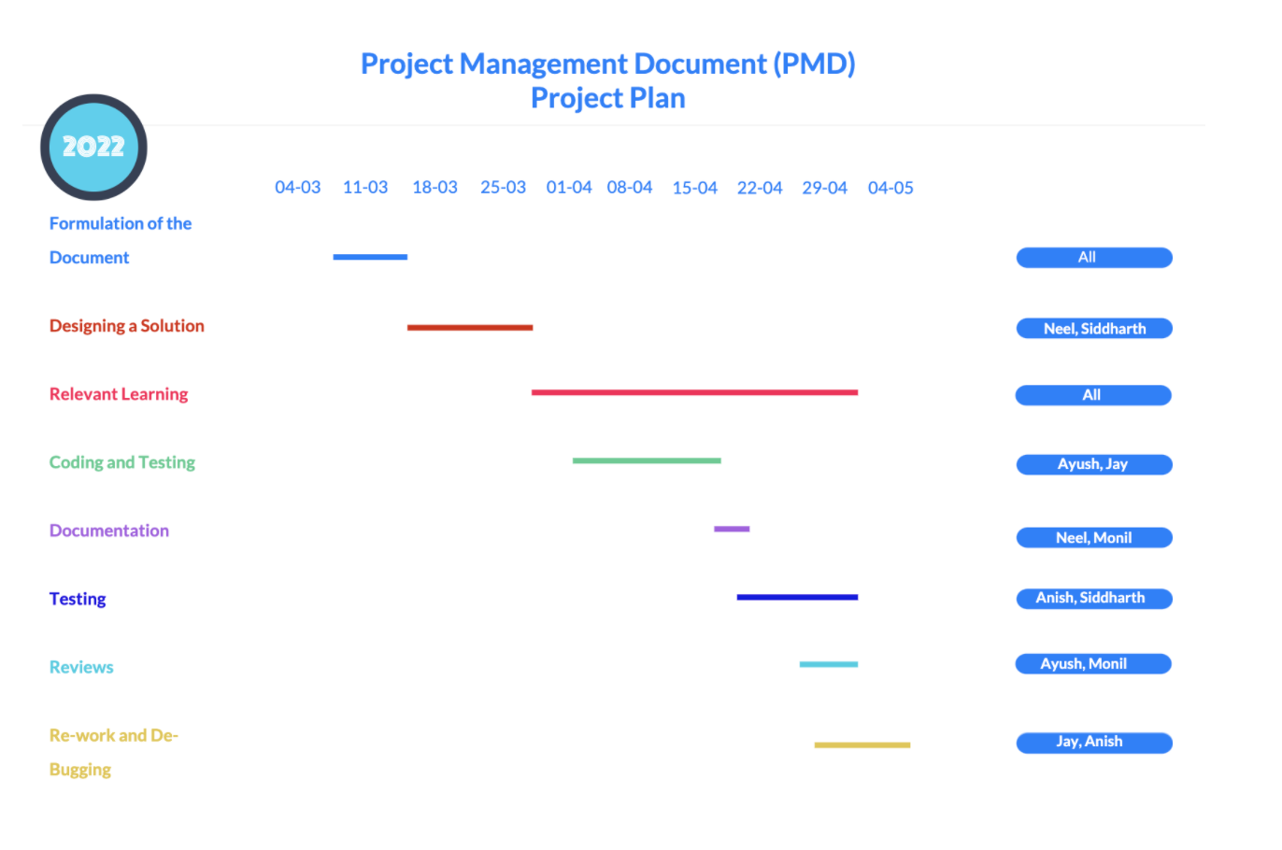
Gantt Chart for entire project

Slide 17
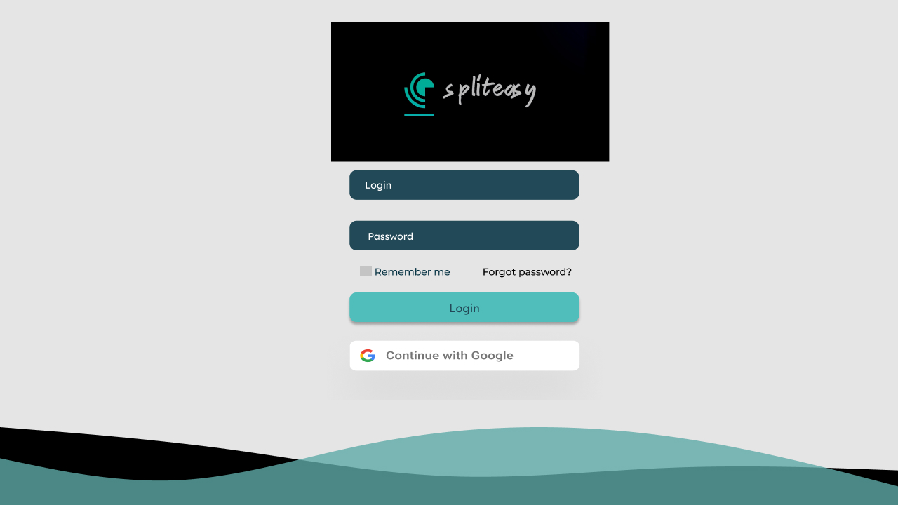
Application Navigation using UI/UX

Slide 18
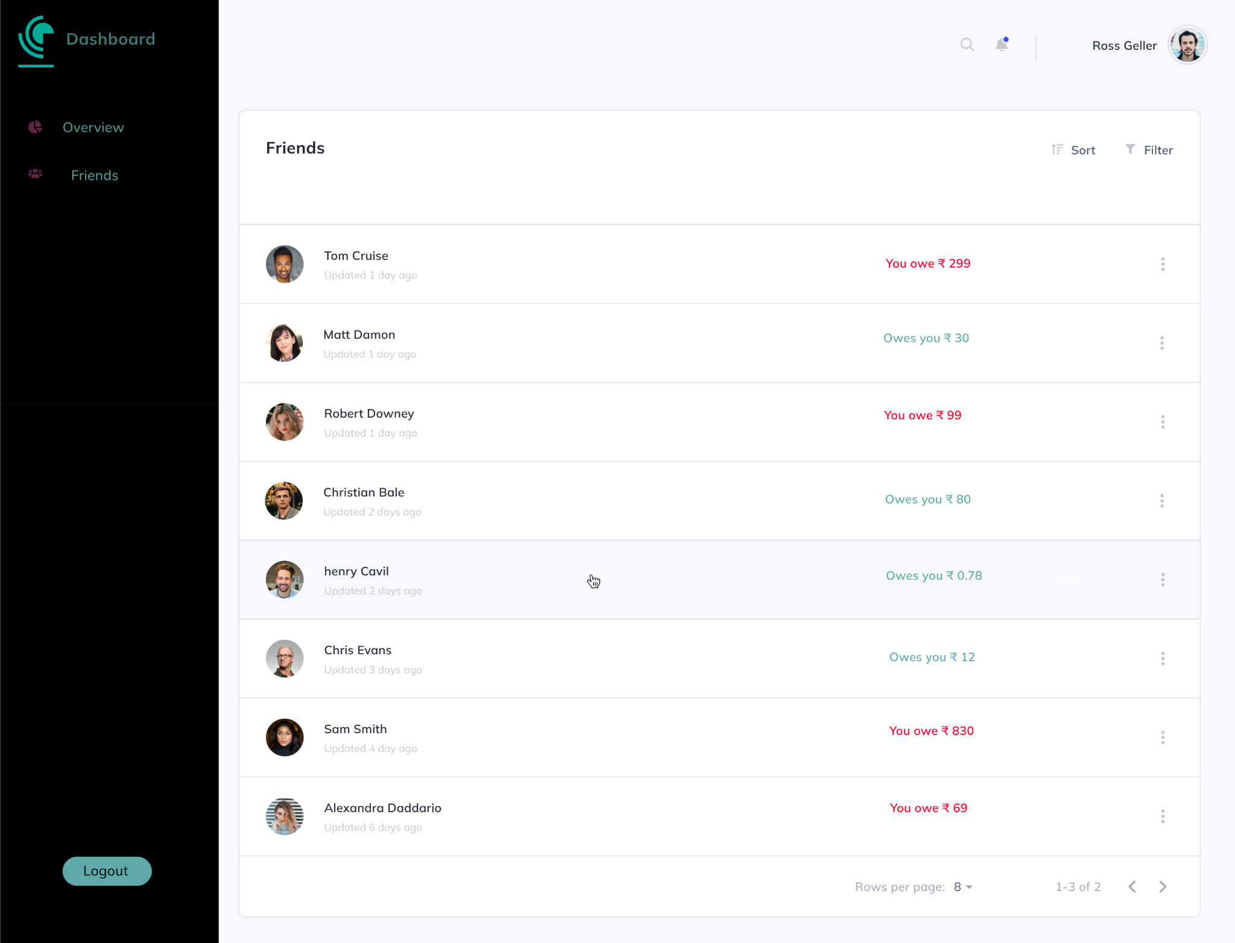

Slide 19
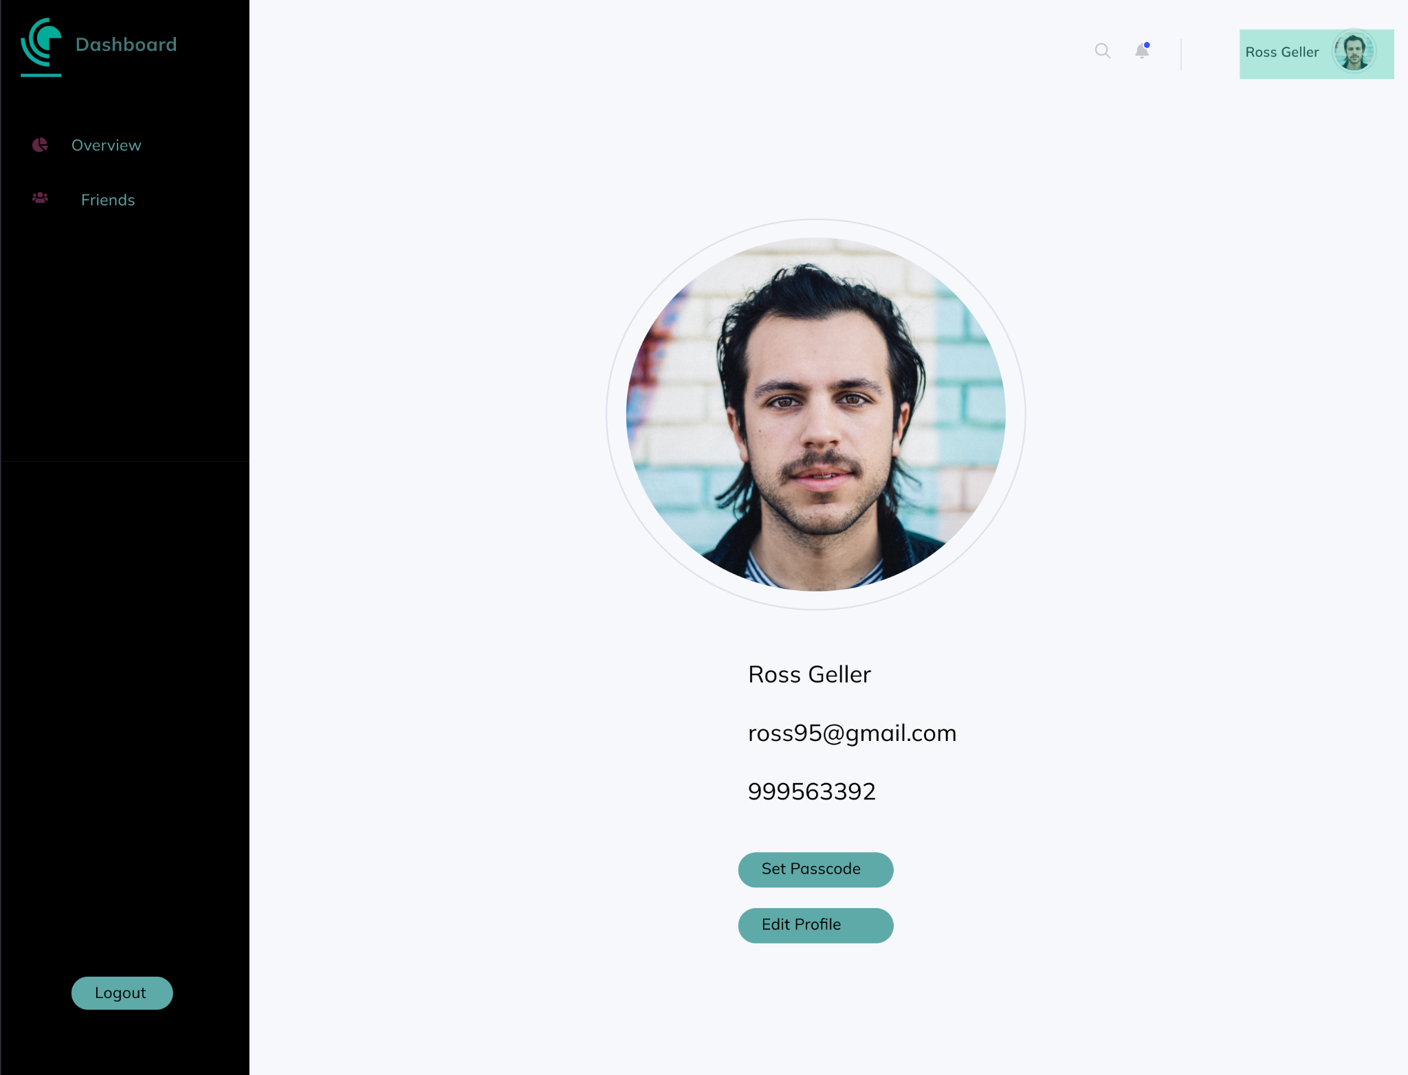

Slide 20
Summary of Test Plan
We have prepared a detailed and thorough list of test cases to cover all possible scenarios, that could be faced in a real life scenario.
The format for testing the system consists of the following:
Test case
Test Data
Expected Result

Slide 21
Test Cases - Examples
Test Case Objective | Test Data | Expected Result
Test the add/delete/settle up expenses functionality | Description for the expense, amount owed or lent and the users to split the amount with. | The net balance for each user involved in the expense should be updated correctly.
 | Simultaneous add/delete/settle up expenses for the same user | The output should be correct, and the system should ensure that these transactions are atomic.
Check if all the transactions added (involving the current user), are displayed in the activity section | Add a valid transaction for a given logged-in user | All the expenses added should be displayed without fail in the activity section.

Slide 22
GitHub Link for our project
https://github.com/anish-parekh/SplitEasy

Slide 23
THANK YOU

